Slide 1
Foundations of Cryptography cryptography, confidentiality, integrity, authentication, non-repudiation, probabilistic algorithm
LiangFeng Zhang
zhanglf@shanghaitech.edu.cn

Slide 2
Course Information
Lectures: (Tuesday 15:00-16:40; Thursday 15:00-16:40/SIST-1D-106)
Textbook:
Introduction to Modern Cryptography (2nd edition), Jonathan Katz and Yehuda Lindell, CRC Press, 2015.
https://www.amazon.com/Introduction-Cryptography-Chapman-Network-Security-ebook/dp/B00QFFY41K
Evaluation:
Attendance: 10%
Homework: 60%
Exam: 30%
Course Webpage: egate-Blackboard (互动教学平台)
密码学

Slide 3
Glossary
Committee on National Security Systems (CNSS)
National Security Telecommunications and Information Systems Security Committee, 1990
Committee on National Security Systems, 2001
Members: CIA, DIA, DOD, DOJ, FBI, NSA, National Security Council, United States Military Services, DISA, NGA, NIST, NRO
National Institute of Standards and Technology (NIST)
National Bureau of Standards, 1901-1988
National Institute of Standards and Technology, 1988-present
Publication of cryptographic algorithm standards
AES: advanced encryption standard //FIPS 197

Slide 4
Information
DEFINITION:
Facts and ideas, which can be represented (encoded) as various forms of data.
Knowledge -- e.g., data, instructions -- in any medium or form that can be communicated between system entities..
-- Committee on National Security Systems (CNSS) Glossary // CNSSI-4009
A measure of freedom of choice when one selects a message
Information resolves uncertainty
-- The mathematical theory of communication, C. Shannon W. Weaver, 1963

Slide 5
Information System
DEFINITION:
A discrete set of information resources organized for the collection, processing, maintenance, use, sharing, dissemination, or disposition of information.
-- CNSSI-4009
Example: Computer Information System
Hardware, Software, Databases, Networks, Procedures

Slide 6
Information Security
DEFINITION: online or offline security
The protection of information and information systems from unauthorized access, use, disclosure, disruption, modification, or destruction in order to provide confidentiality, integrity, and availability.
-- CNSSI-4009
Computer Security: part of information security
Measures and controls that ensure confidentiality, integrity, and availability of the information processed and stored by a computer.
-- CNSSI-4009

Slide 7
Cybersecurity
Prevention of damage to, protection of, and restoration of computers, electronic communications systems, electronic communications services, wire communication, and electronic communication, including information contained therein, to ensure its availability, integrity, authentication, confidentiality, and nonrepudiation. //remark: Cyberspace is a separate space; for digital data
--CNSSI-4009, 2015
The ability to protect or defend the use of cyberspace from cyber attacks.
-- NISTIR-7298

Slide 8
Network Security
Measures that protect and defend information and information systems by ensuring their availability, integrity, authentication, confidentiality, and non-repudiation.
These measures include providing for restoration of information
systems by incorporating protection, detection, and reaction
capabilities. //online security
-- CNSSI-4009

Slide 9
Cryptography
The study of mathematical techniques for securing digital information, systems, and distributed computations against adversarial attacks
--“Introduction to Modern Cryptography”, Katz, Lindell, 2015
The study of mathematical techniques related to aspects of information security such as confidentiality, data integrity, entity authentication, and data origin authentication
--“Handbook of Applied Cryptography”, Menezes, van Oorschot, Vanstone, 1996
The discipline that embodies the principles, means, and methods for the providing information security, including confidentiality, data integrity, non-repudiation, and authenticity.
-- CNSSI-4009

Slide 10


Confidentiality
“Transfer $1000 from Alice to David”
Alice
Bob (bank)
Charlie
The property that sensitive information is not disclosed to unauthorized individuals, entities, or processes.
--FIPS 140-2

Slide 11
Integrity
“Transfer $1000 from Alice to David”
Alice
Bob (bank)
Charlie

Slide 12
Integrity
“Transfer $1000 from Alice to Charlie”
Alice
Bob (bank)
Charlie

Slide 13
Integrity
“Transfer $10000 from Alice to Charlie”
Alice
Bob (bank)
Charlie
The property that sensitive data has not been modified or deleted in an unauthorized and undetected manner.
--FIPS 140-2

Slide 14
Authentication
“Transfer $1000 from Alice to Charlie”
Alice
Bob (bank)
Charlie
The process of establishing confidence in the identity of users or information systems.
--SP 800-63

Slide 15
Non-Repudiation
“Transfer $1000 from Alice to David”
$$I never send this instruction‼!$$
Alice
Bob (bank)
$$I never receive this instruction‼!$$
Assurance that the sender of information is provided with proof of delivery and the recipient is provided with proof of the sender’s identity, so neither can later deny having processed the information.
--CNSSI-4009; SP 800-60

Slide 16
Overview
Classical Cryptography
Historical Ciphers, Perfect Secrecy, Principles of Modern Cryptography
Private-Key Cryptography
Private-Key Encryption
Message Authentication Codes
Hash Functions
Practical Constructions
Public-Key Cryptography
Key Exchange
Public-Key Encryption
Digital Signature
Advanced Topics
Secret Sharing, PIR, Secure Computation

Slide 17
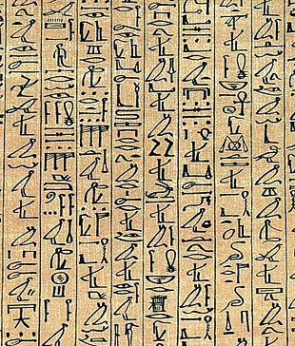

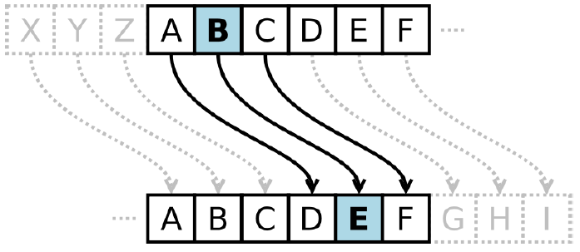
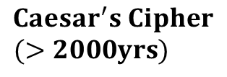
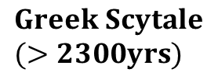
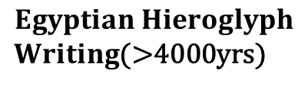
History of Encryption
$$Egyptian Hieroglyph$$
$Writing$(>4000yrs)
$$Greek Scytale$$
$(>2300yrs)$
$$Caesar^{′}s Cipher$$
$(>2000yrs)$

Slide 18
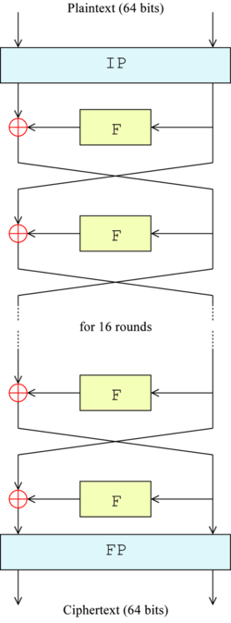
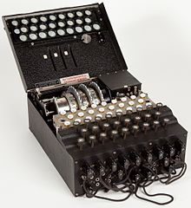
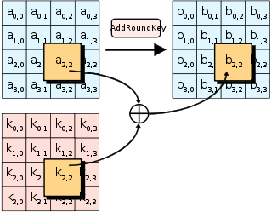
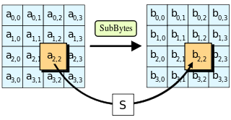
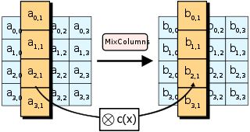
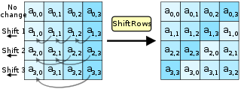



History of Encryption
$$Enigma$$
$$DES$$
$$AES$$

Slide 20
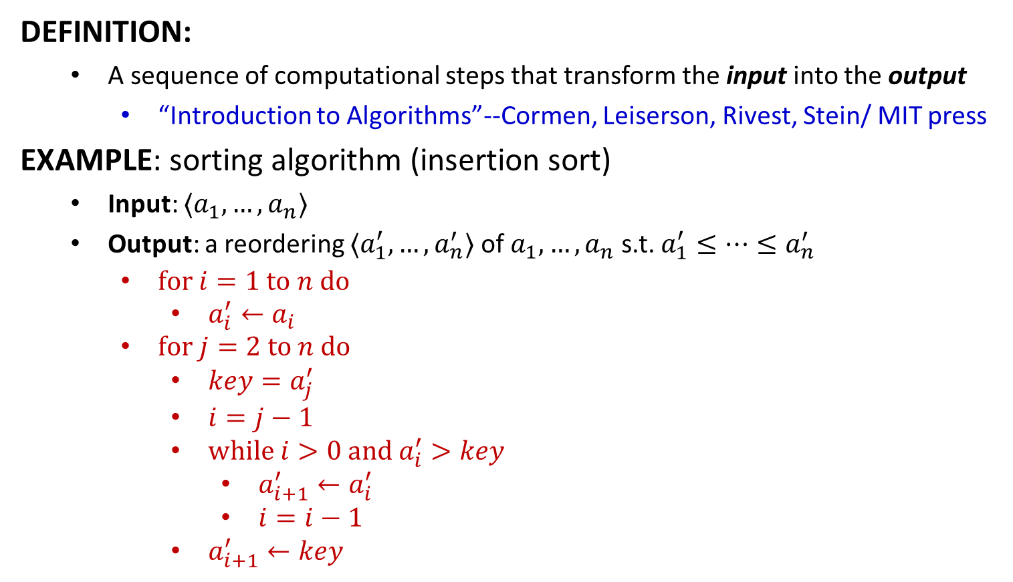
Algorithm
DEFINITION:
A sequence of computational steps that transform the input into the output
“Introduction to Algorithms”--Cormen, Leiserson, Rivest, Stein/ MIT press
EXAMPLE: sorting algorithm (insertion sort)
Input: $〈a_{1},…,a_{n}〉$
Output: a reordering $〈a_{1}^{′},…,a_{n}^{′}〉$ of $a_{1},…,a_{n}$ s.t. $a_{1}^{′}≤⋯≤a_{n}^{′}$
$for i=1 to n do$
$a_{i}^{′}←a_{i}$
$for j=2 to n do$
$key=a_{j}^{′}$
$i=j−1$
$while i>0 and a_{i}^{′}>key$
$a_{i+1}^{′}←a_{i}^{′}$
$i=i−1$
$a_{i+1}^{′}←key$
Deterministic Algorithm: The behavior of the algorithm is completely determined by the input.

Slide 21
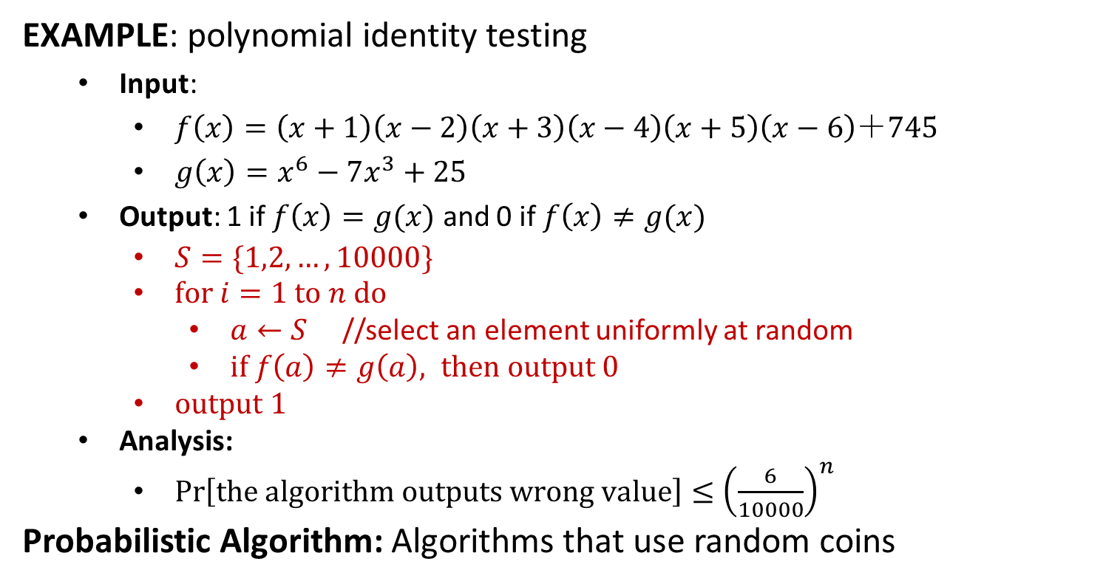
Algorithm
EXAMPLE: polynomial identity testing
Input:
$f\left(x\right)=\left(x+1\right)\left(x−2\right)\left(x+3\right)\left(x−4\right)\left(x+5\right)\left(x−6\right)＋745$
$g\left(x\right)=x^{6}−7x^{3}+25$
Output: 1 if $f\left(x\right)=g(x)$ and 0 if $f\left(x\right)≠g(x)$
$S=\{1,2,…,10000\}$
$for i=1 to n do$
$a←S$ //select an element uniformly at random
$if f\left(a\right)≠g\left(a\right), then output 0$
$output 1$
Analysis:
$\operatorname{Pr}\left[the algorithm outputs wrong value\right]≤{\left(\frac{6}{10000}\right)}^{n}$
Probabilistic Algorithm: Algorithms that use random coins

